Slide 1
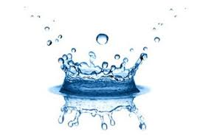
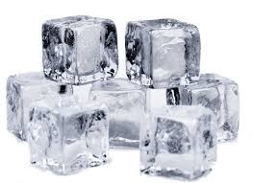
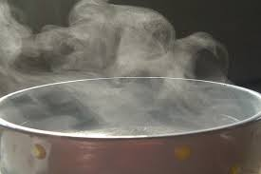
Solids, Liquids and Gases
What are we doing today?
Give examples of each
Discuss the properties of each one
Describe how solids, liquids and gases are arranged

Slide 2
What do these three words mean?
Write your ideas in the circles
Solids Liquids Gases

Slide 3
Which one is a solid, liquid, gas?

Slide 4
Keywords
Fixed
Flow
Squash
Heavy

Slide 5
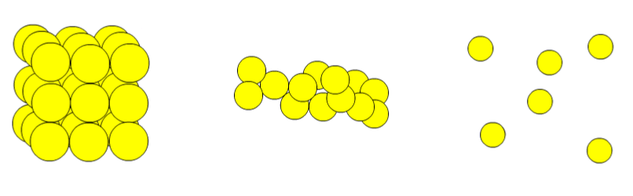
Which one is a solid?

Slide 6
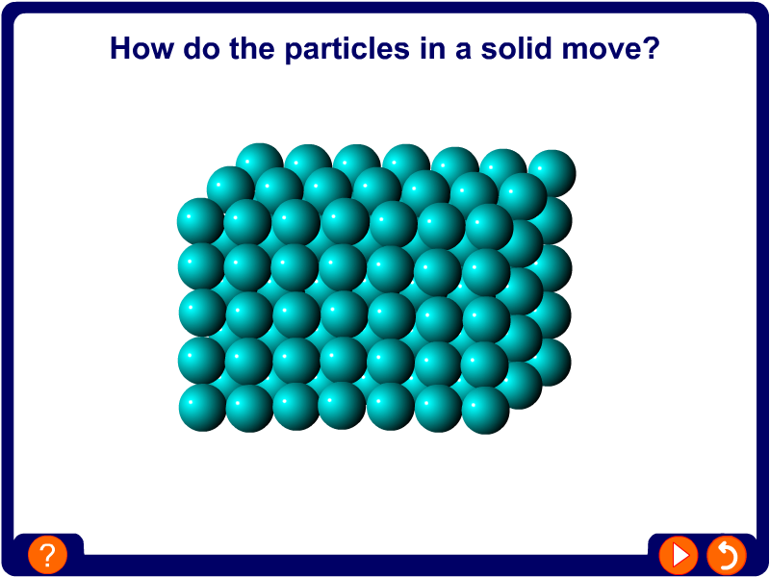

Slide 7
Which one is a liquid?

Slide 8
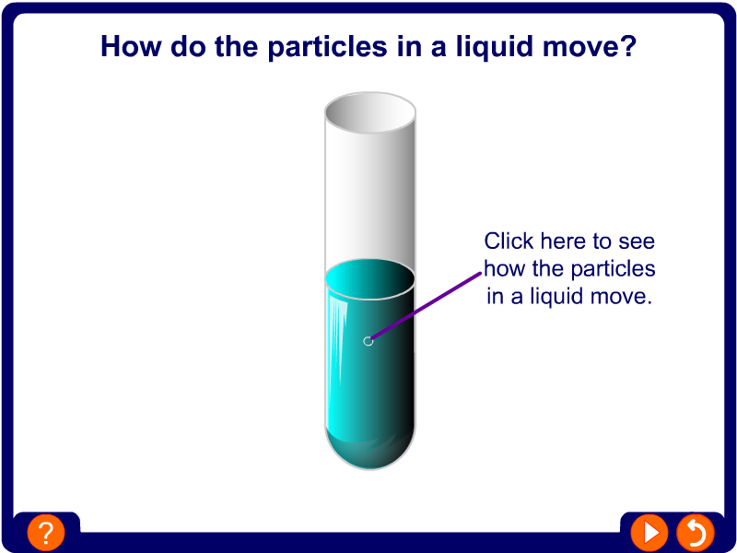

Slide 9
Which one is a gas?

Slide 10
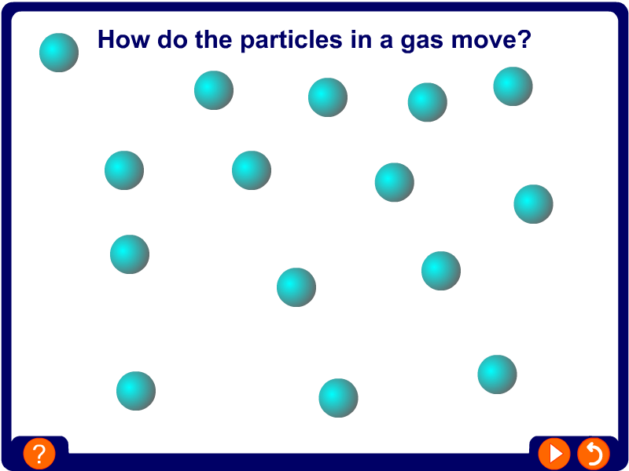

Slide 11
Special Ice

Slide 12
melting
evaporation
freezing
condensation

Slide 13
Modelled sentences
Gas Liquid Solid | moves | slowly. quickly.
Gas Liquid Solid | has a does not have a is is not | fixed shape. heavy.

